Slide 1
Tour agency
Andrei Tatarynau

Slide 2
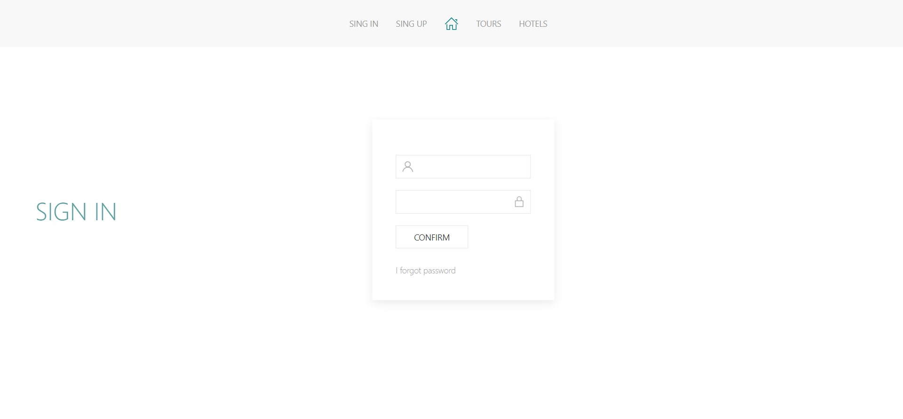
http://localhost:8080/authentication

Slide 3
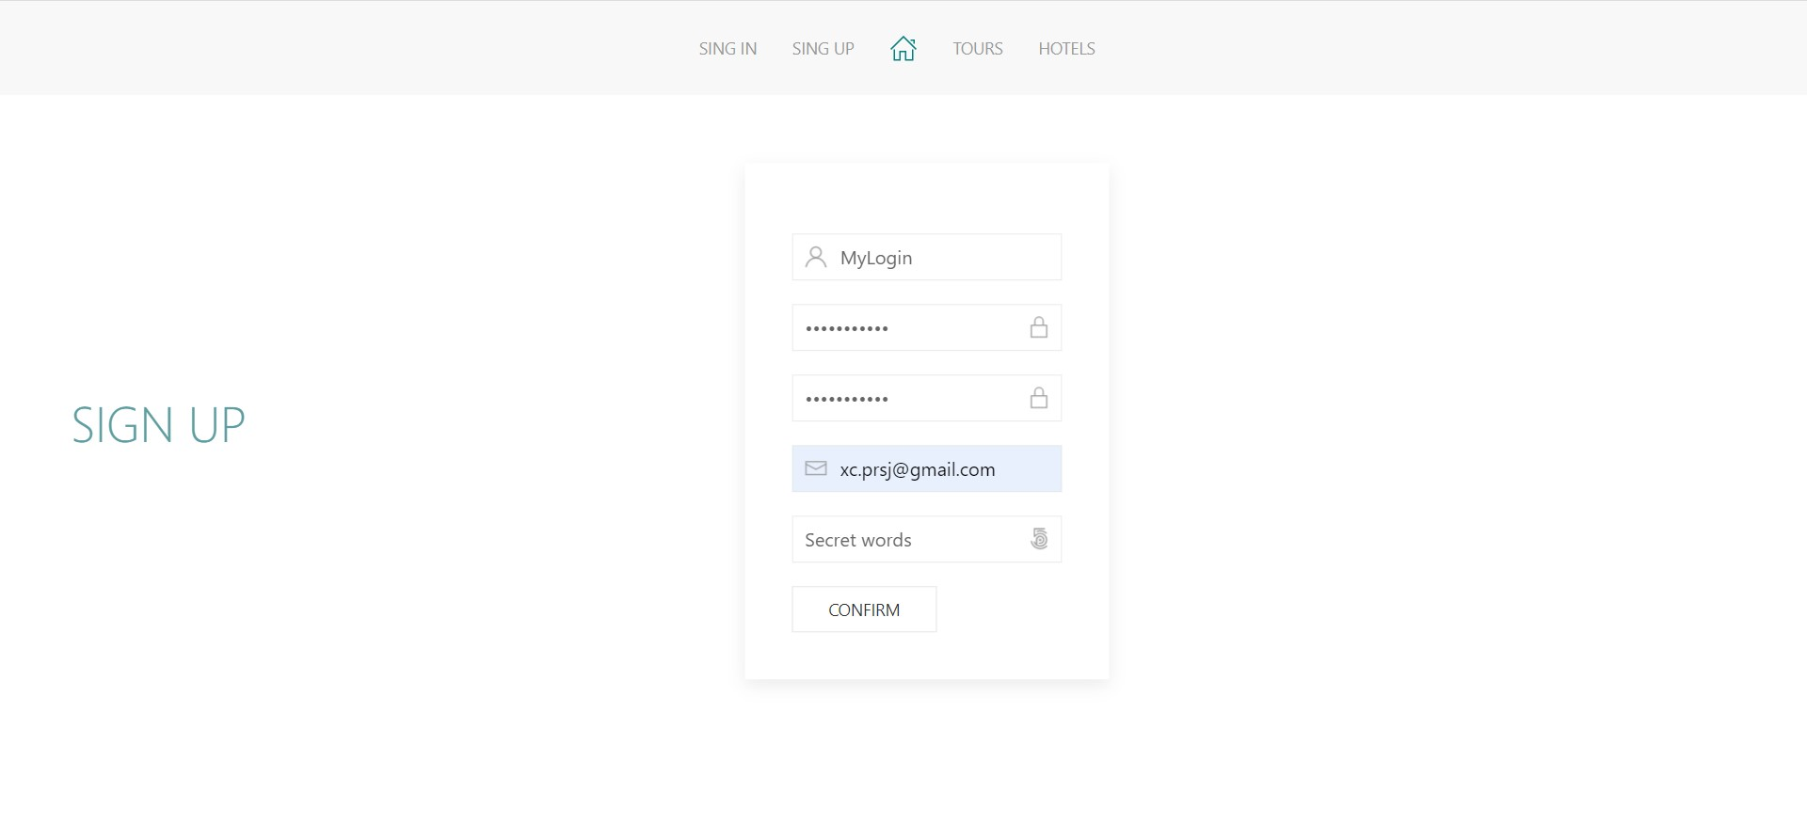
http://localhost:8080/registration

Slide 4
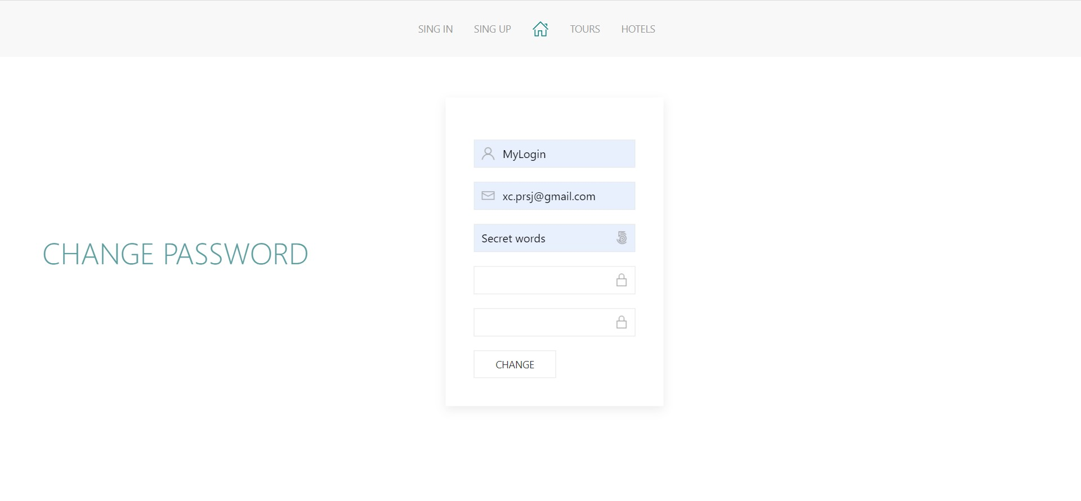
http://localhost:8080/changePassword

Slide 5
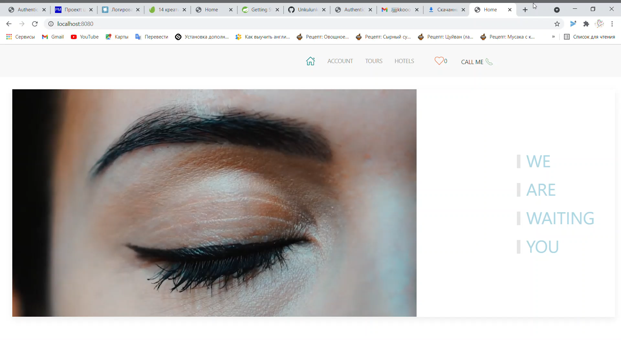
http://localhost:8080

Slide 6
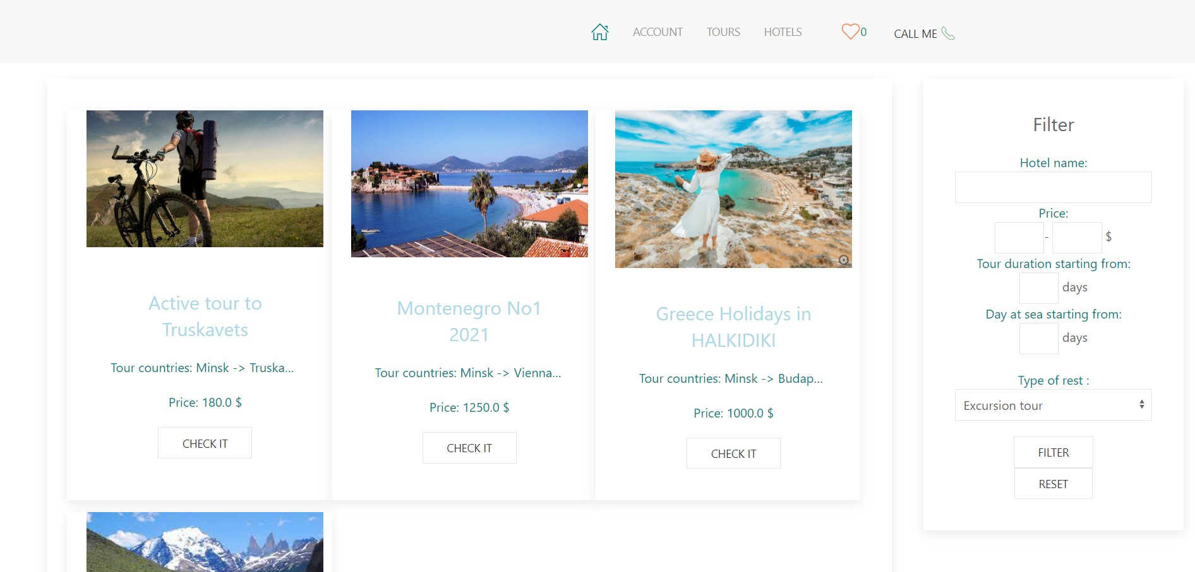
http://localhost:8080/tour/all

Slide 7
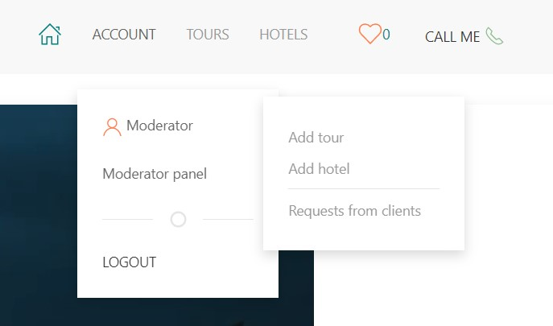

Slide 8
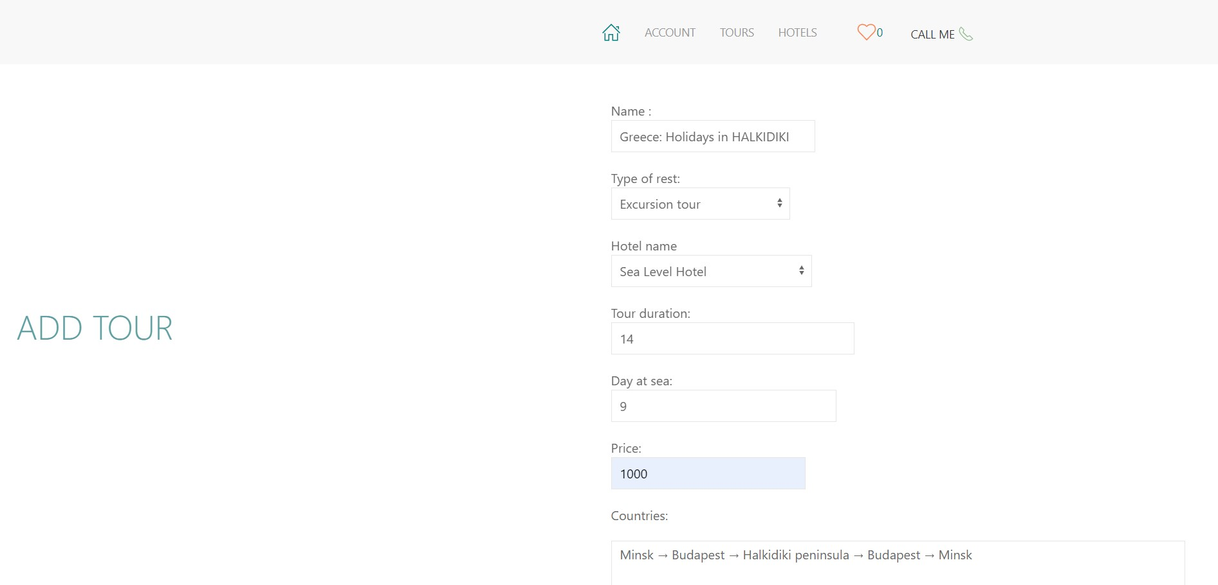
http://localhost:8080/tour/add

Slide 9
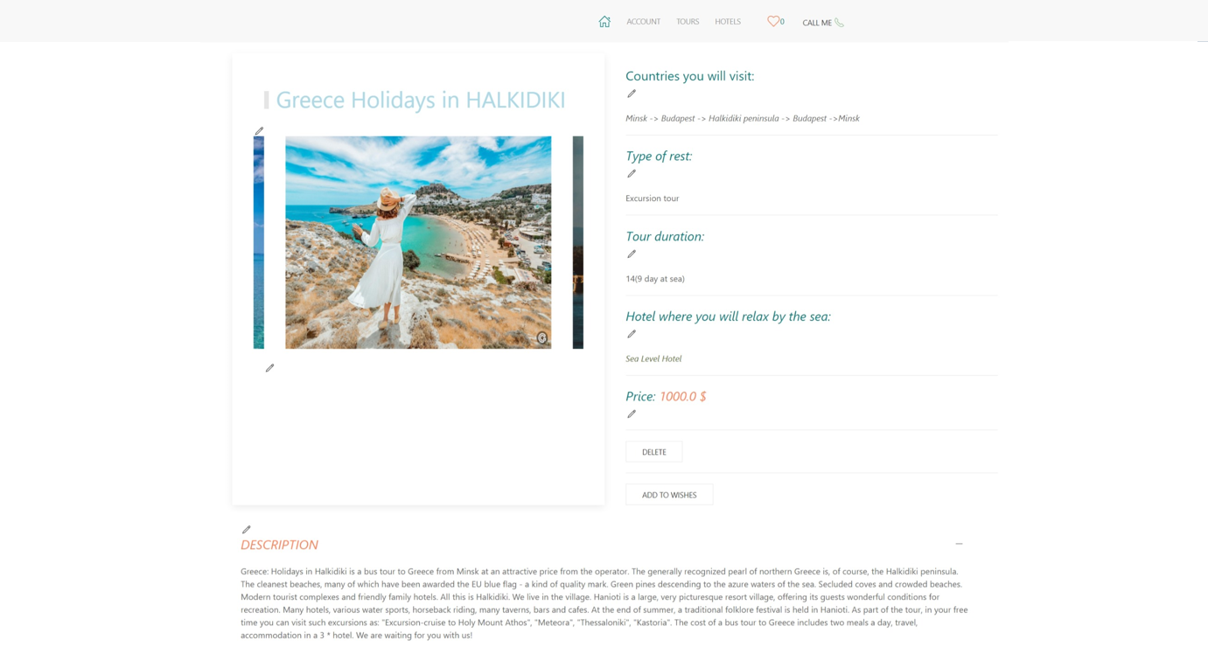
http://localhost:8080/tour/3

Slide 10
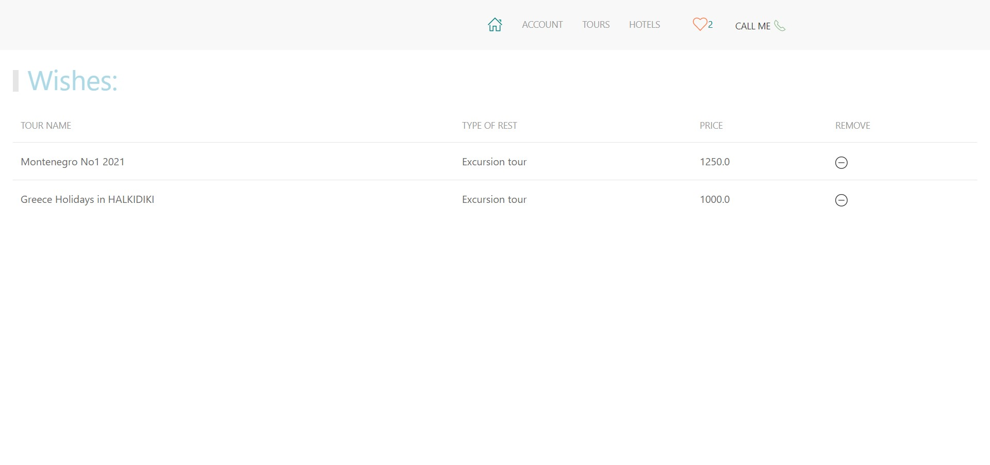
http://localhost:8080/wishes

Slide 11
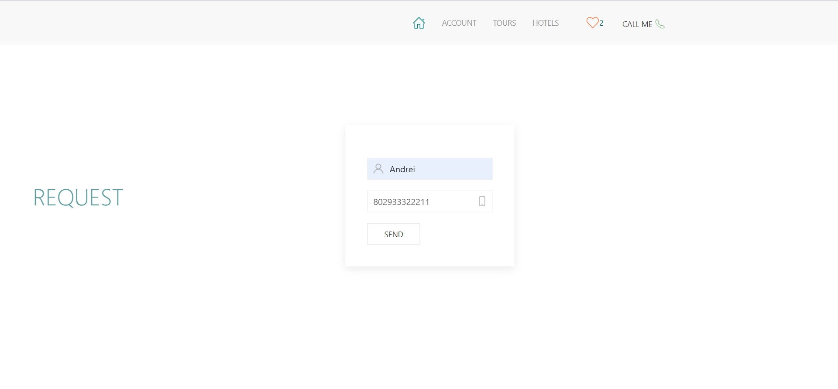
http://localhost:8080/request

Slide 12
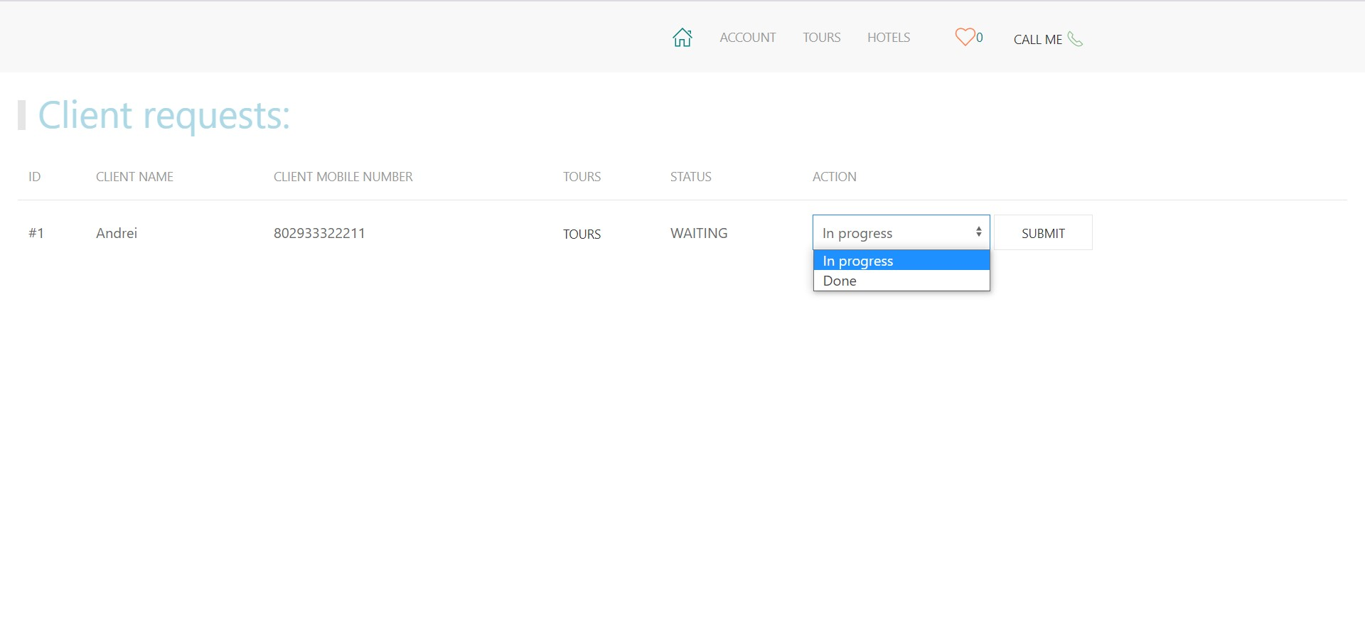
http://localhost:8080/request/fromClients

Slide 13
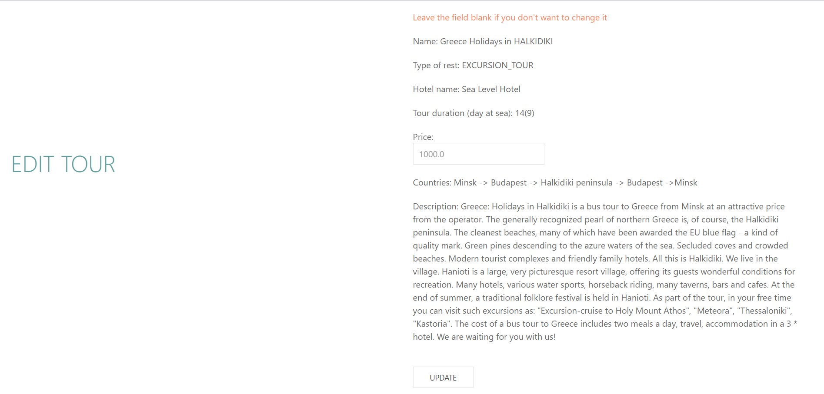
http://localhost:8080/tour/edit?id=3&nameOfEditableField=price

Slide 14
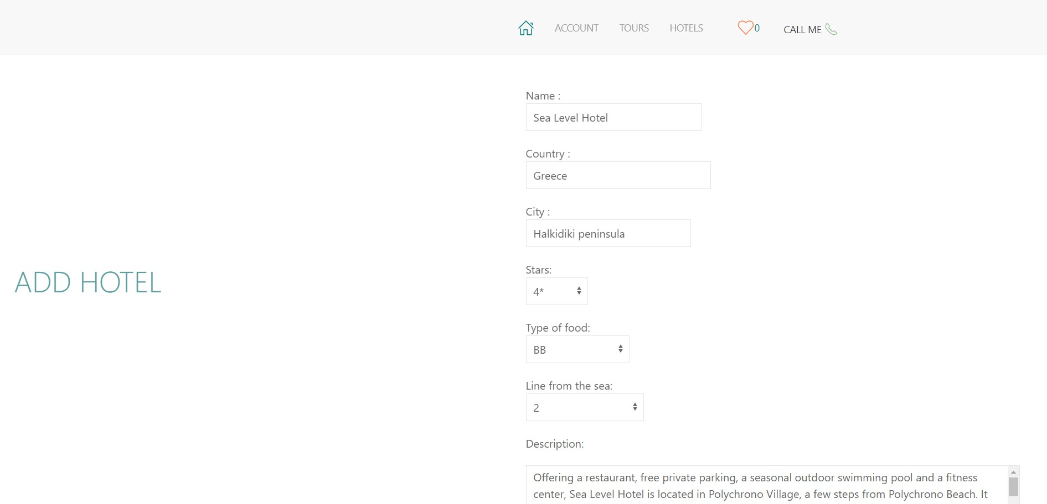
http://localhost:8080/hotel/add

Slide 15
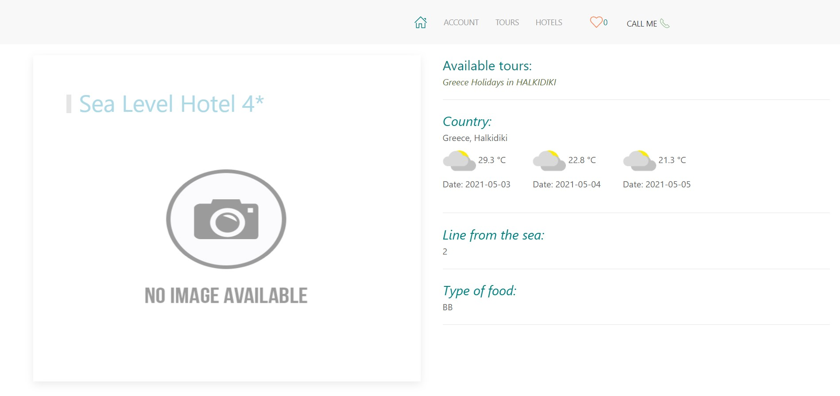
http://localhost:8080/hotel/1

Slide 16
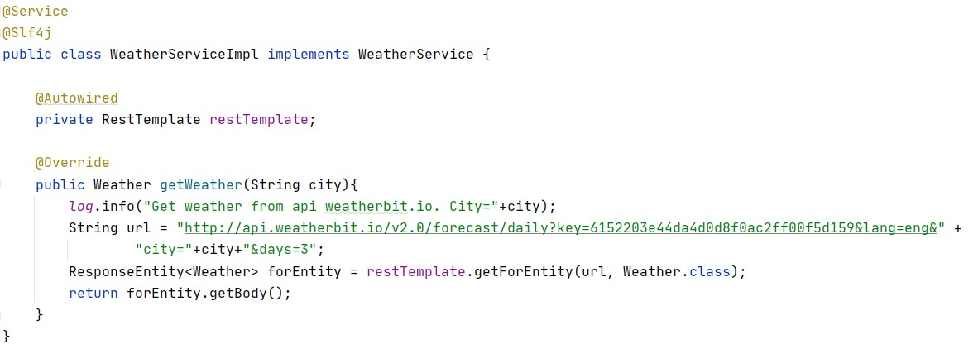
Api Weatherbit.io

Slide 17
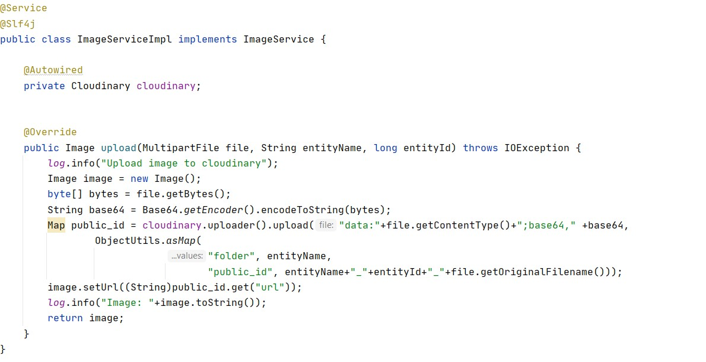
Image Content Delivery Network

Slide 18
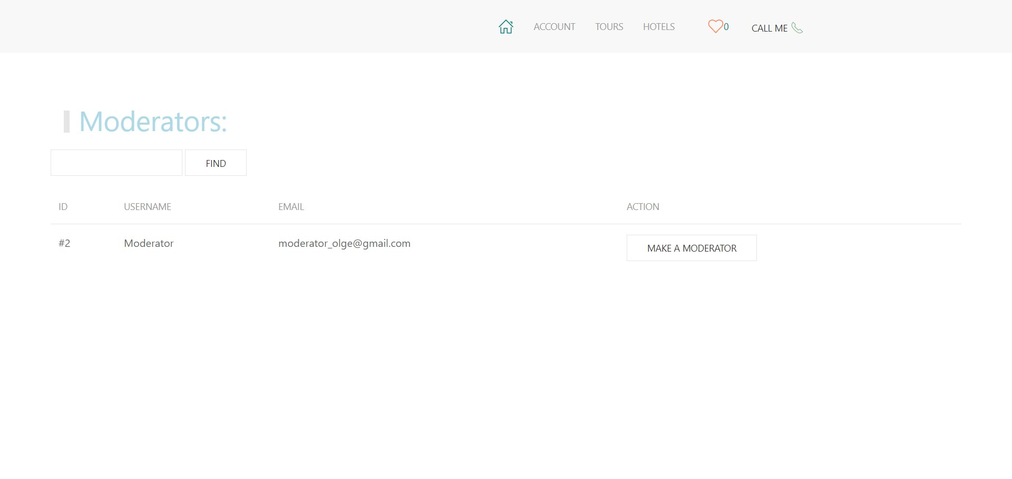

Slide 19
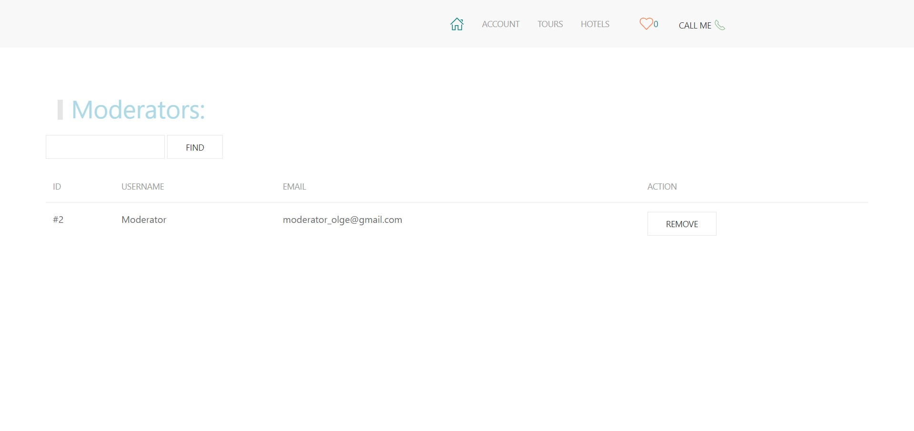

Slide 20
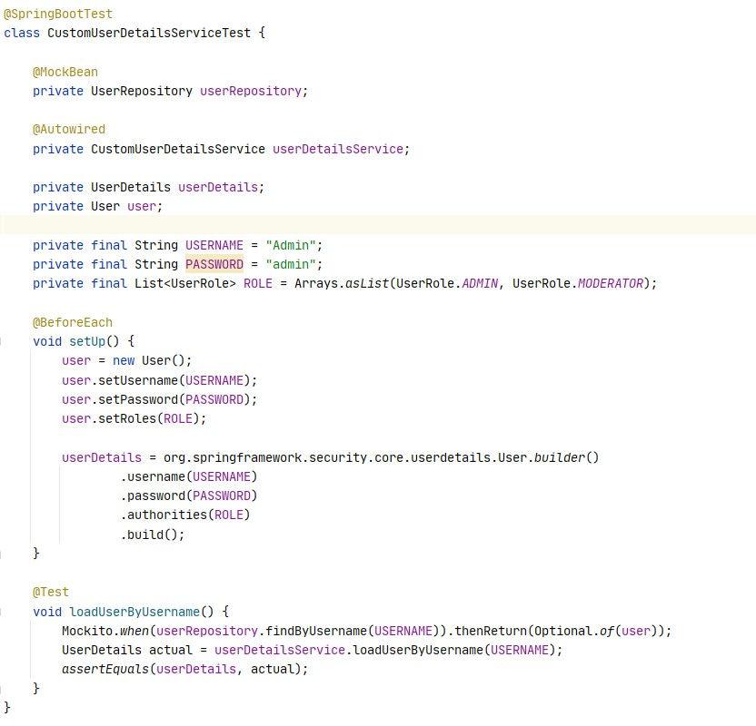
Testing

Slide 21
Finish

